Slide 1

SWAP: Synchronized Weaving of Adjacent Packets for Network Deadlock Resolution
http://synergy.ece.gatech.edu
Mayank Parasar, Natalie Enright Jerger, Paul V. Gratz, Joshua San Miguel and Tushar Krishna
mparasar3@gatech.edu

Slide 2
Challenge: Routing Deadlock
Deadlock: Cyclic dependence between packets
Renders the forward progress of packets impossible
Correctness problem, can cause system failure
Network
6
9
10
5
Network
Deadlock
Network
5
6
10
9
Destination Router-5
Network
5

Slide 3
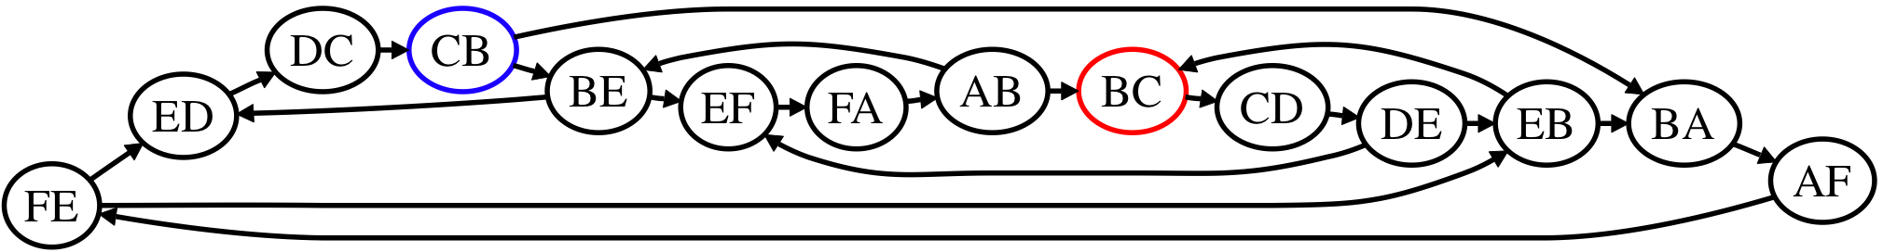
Channel Dependency Graph (CDG)
F
D
E
Cycle
A
C
B
Function of Topology and Routing Algorithm
Deadlock occurs because of cycles present in the channel dependency graph of the topology

Slide 4


Qualitative Comparison of Deadlock Freedom Mechanisms
Design | Resolution Type | Full Path Diversity | No Extra VCs | Topology Agnostic | No Deadlock Detection
Dally/Turn Restriction [1] | No Cycle
Duato/Escape VC [2] | Escape
Injection Restriction [3] | Bubble
Deflection [4] | Misroute
Coordination [5] | Synchronize
? | ??
*
*
*in all VCs except escape VC
Can we do better?
[1]:
Deadlock-free message routing in multiprocessor interconnection networks [IEEE Trans. Computer, 1987]
[2]:
A new theory of deadlock-free adaptive routing in wormhole networks. [IEEE Trans. On Parallel and Dist. Sys, 1993]
[3]:
Bubble Flow Control [IPDPS 2011]
[4]:
BLESS [ISCA’09] CHIPPER [HPCA’11]
[5]:
DISHA [IPDPS’95] Static Bubble [HPCA’17] SPIN [ISCA’18]

Slide 5
Outline
Background: Deadlocks
Current Solutions
SWAP
Walk-through
Concept
Deadlock freedom proof
Router microarch
Evaluations
Methodology
Results
Conclusion

Slide 6

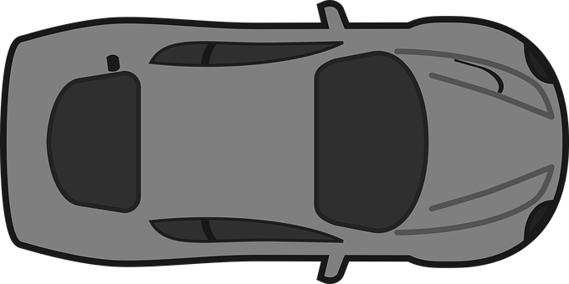
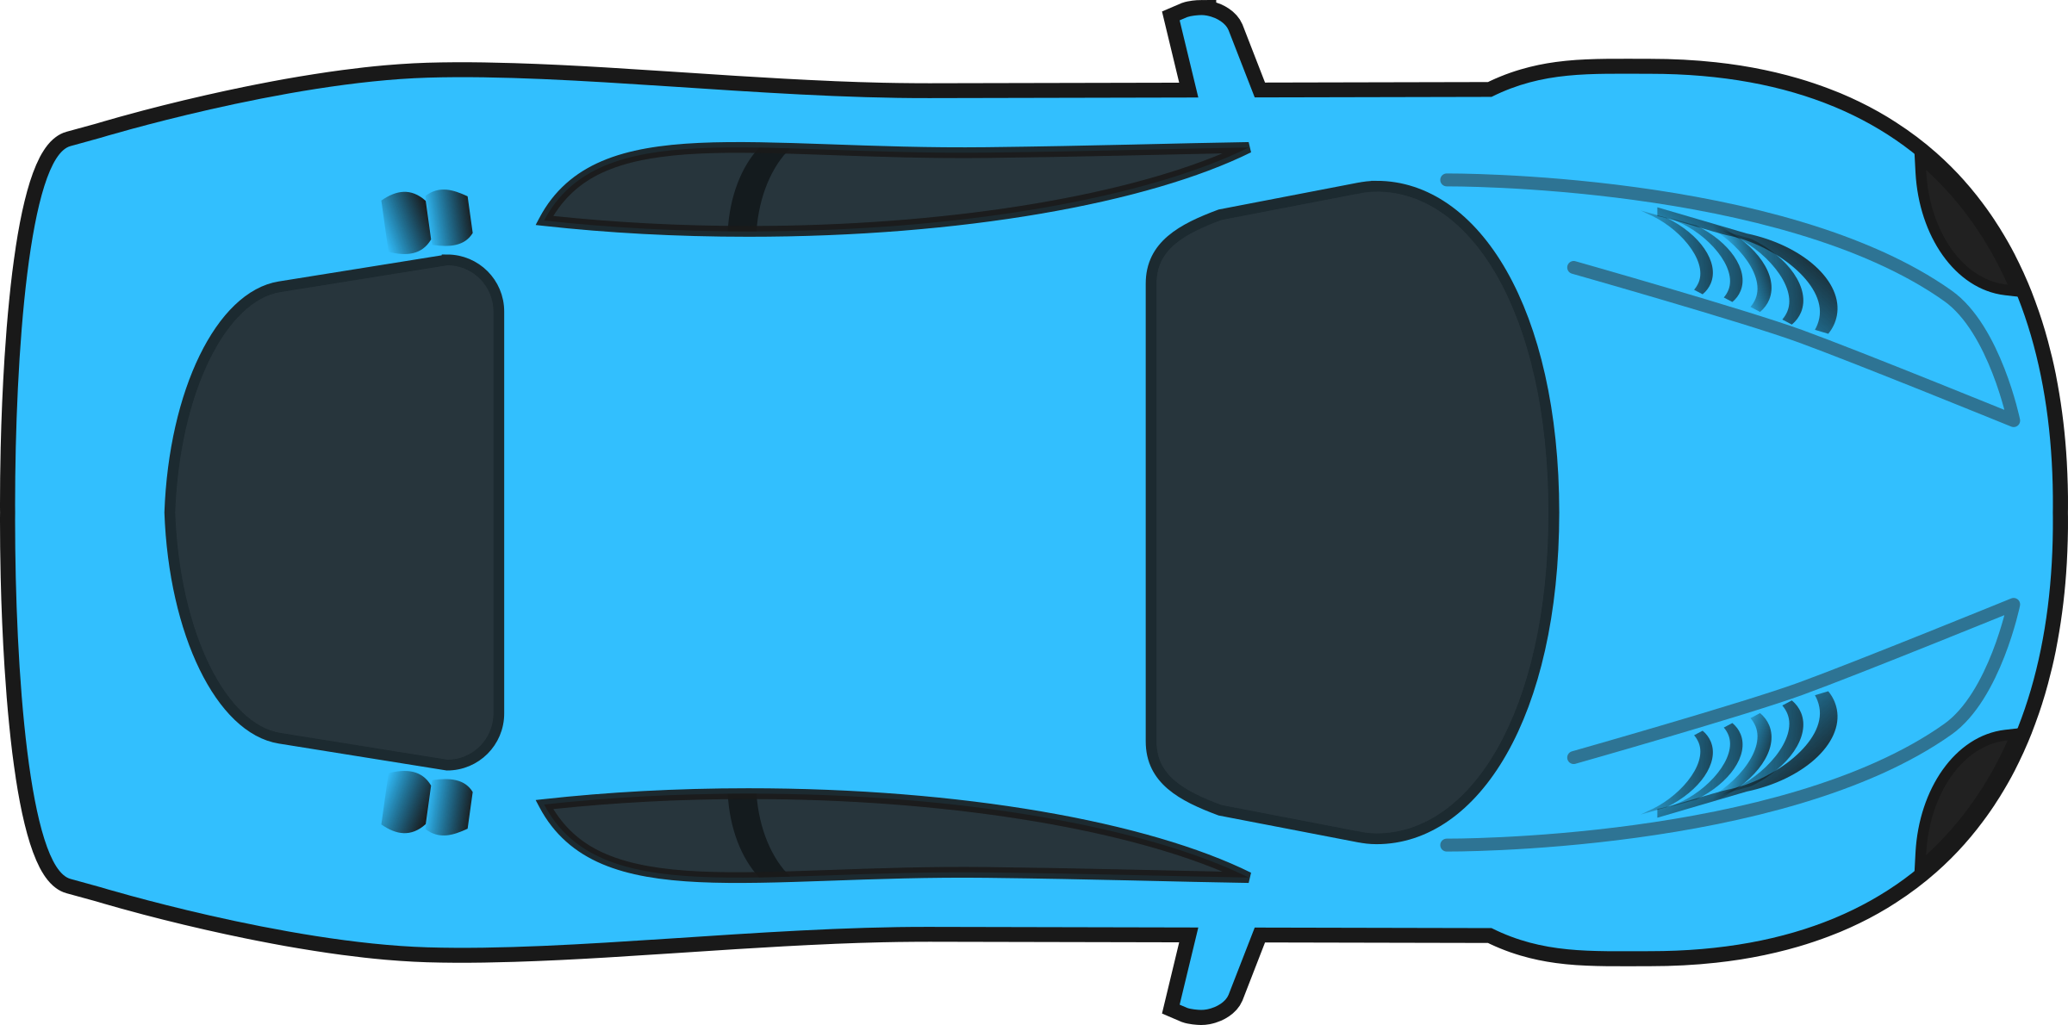
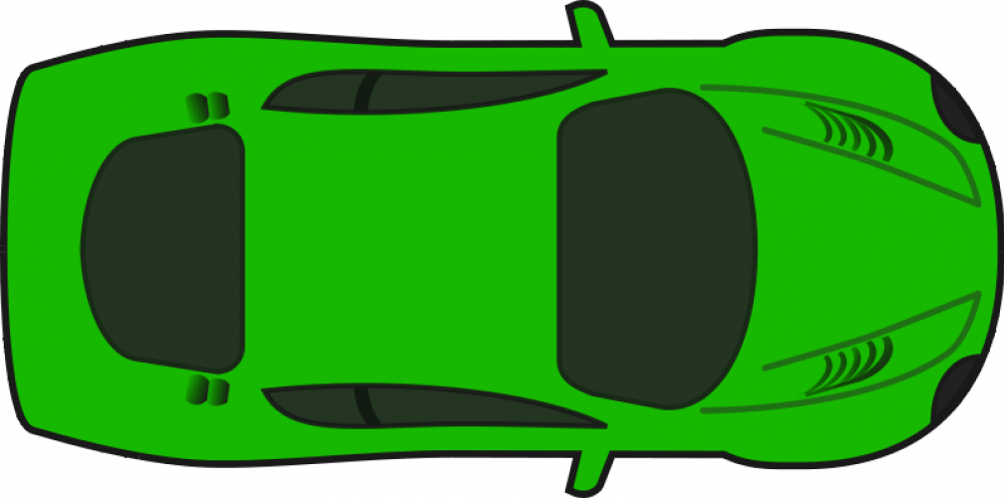
Traffic Deadlock
Deadlock

Slide 7
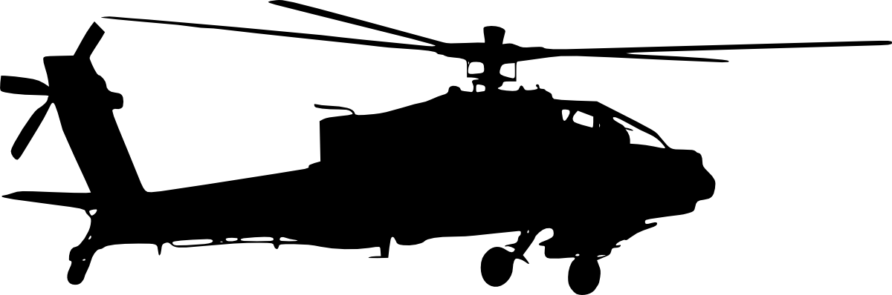
Swap to resolve traffic deadlock
Deadlock

Slide 8
Key Terms
‘swapFwd’ packet always makes forward progress
‘swapBack’ packet is interchanged with swapFwd packet in SWAP
‘Backtrack’ is an act where ‘swapBack’ yield its buffer for ‘swapFwd’ to make forward progress

Slide 9
SWAP to resolve Network Deadlock
SWAP
Network
swapFwd
9
10
5
9
Deadlock Resolved!
Network
Deadlock
Network
5
6
6
10
swapBack
Eject
Network
backtrack

Slide 10
SWAP in network
backtrack
backtrack
d
f
c
A
B
C
y
x
F
E
D
z
AB
BC
Eject
Deadlock Resolved
c
Acyclic
FA
Cyclic
CD
Runtime Channel Dependency Graph
EF
DE

Slide 11
SWAP: Key Idea
Swap implies interchanging two packets from two adjacent routers
Requires no additional buffers
Leverages the bidirectional links to simultaneously send two packets
Topology and Routing Algorithm agnostic
If any VC at the downstream is empty, swap is not performed

Slide 12
Outline
Background: Deadlocks
Current Solutions
SWAP
Walk-through
Concept
Deadlock freedom proof
Router microarch
Evaluations
Methodology
Results
Conclusion

Slide 13
SWAP Datapath - Concept
0
0
0
0
0
0
1
A
B
1
A
1
B
1
B
1
A
1
Swap=0
Swap=0
Router
Swap=1
Swap=1
Swap=0
Swap=0
clk
Packet
clk
clk
Buffer
Periodic in-place exchange of packets can be used to break deadlock

Slide 14
SWAP Control Path
When to initiate a swap?
Every router gets the chance to initiate a swap every p cycles
p is configurable
No explicit deadlock detection
How to swap?
The router selects a packet and sends a swap_req to the downstream router at its output port
If packet at any VC at the downstream is ejecting, swap is not performed

Slide 15
Outline
Background: Deadlocks
Current Solutions
SWAP
Walk-through
Concept
Router microarch
Deadlock freedom proof
Evaluations
Methodology
Results
Conclusion

Slide 16
Router Micro-Architecture
30% lower area than Escape VC router
4% higher area than XY/West-First router
Least expensive!

Slide 17
SWAP Datapath - Router Microarchitecture
swapFwd
swapBack

Slide 18
Outline
Background: Deadlocks
Current Solutions
SWAP
Walk-through
Concept
Router microarch
Deadlock freedom proof
Evaluations
Methodology
Results
Conclusion

Slide 19
SWAP: Deadlock Freedom Proof
Deadlock-Freedom
Every packet gets a chance to perform a swap, the network is deadlock free (i.e., no packed is blocked indefinitely)
Enforced via round-robin priority for all router input ports
Livelock Freedom
Backtracked packet can move forward by two hops before being backtracked again
Enforced by period between swaps and fair VC selection scheme

Slide 20
Outline
Background: Deadlocks
Current Solutions
SWAP
Concept
Walk-through
Deadlock freedom proof
Router microarch
Evaluations
Methodology
Results
Conclusion

Slide 21
Evaluations
Gem5 for full system and SE mode simulations
X86 and RISC-V ISA
Garnet2.0 for network simulation
SWAP uses random routing algorithm
SWAP uses VCT flow control
Evaluated on regular and irregular topologies
Evaluated on synthetic traffic patterns

Slide 22
Outline
Background: Deadlocks
Current Solutions
SWAP
Concept
Definition
Walk-through
Deadlock freedom proof
Router microarch
Evaluations
Methodology
Results
Conclusion

Slide 23
Synthetic Traffic
40% higher throughput than DoR
25% higher throughput than Escape VC
44% higher throughput than Deflection
10% higher throughput than Deadlock Detection
More results in paper

Slide 24
Link Traversal Energy
SPIN has 8-10x higher link activity because of probes
Deflection has 60% higher link activity because of continuous misroute
SWAP has close to 0 additional link activity at higher period
More analysis in paper

Slide 25
MESI Cache Coherence
18% speedup on average
Notes:
This is directory based protocol with less network activity

Slide 26
MOESI Cache Coherence
6% speedup on average

Slide 27
Outline
Background: Deadlocks
Current Solutions
SWAP
Concept
Walk-through
Deadlock freedom proof
Router microarch
Evaluations
Methodology
Results
Conclusion
Notes:
Now let me introduce to you the concept of BBR and how it takes an orthogonal approach compared to prior work to resolve deadlocks

Slide 28
Revisiting Qualitative Comparison
Design | Resolution Type | Full Path Diversity | No Extra VCs | Topology Agnostic | No Deadlock Detection
Dally/Turn Restriction [1] | No Cycle
Duato/Escape VC [2] | Escape
Injection Restriction [3] | Bubble
Deflection [4] | Misroute
Coordination [5] | Synchronize
SWAP | Backtrack
*
*
*in all VCs except escape VC
[1]:
Deadlock-free message routing in multiprocessor interconnection networks [IEEE Trans. Computer, 1987]
[2]:
A new theory of deadlock-free adaptive routing in wormhole networks. [IEEE Trans. On Parallel and Dist. Sys, 1993]
[6]:
SWAP [MICRO’19]
[3]:
Bubble Flow Control [IPDPS 2011]
[4]:
BLESS [ISCA’09] CHIPPER [HPCA’11]
[5]:
DISHA [IPDPS’95] Static Bubble [HPCA’17] SPIN [ISCA’18]

Slide 29
Conclusion
Questions?
Deadlock is the problem which every network must solve
Current solutions either require complex deadlock detection or provision extra set of buffers or restrict turns
SWAP provides a novel way of resolving deadlock by swapping packets in the network.
No extra buffer needed as it does in-place swap
Free from complicated deadlock detection circuitry
Provides full path-diversity therefore high performant
Thank you!

